Slide 1
SSL (Secure Sockets Layer)
Jesus “Omar” Gallegos

Slide 2
Answer the following
1) What does SSL stand for?
2) What is needed in order to have an SSL connection?
3) What is the underlining protocol in an SSL connection?
4) Who issues SSL Certificates?
5) What is the future of SSL?

Slide 4
What is SSL
SSL (Secure Sockets Layer) is a standard security protocol for establishing encrypted links between a web server and a browser in an online communication.
The usage of SSL technology ensures that all data transmitted between the web server and browser remains encrypted.
Personal information, passwords, credit card information, etc.
Used by millions of online business to protect customers and transactions remain confidential
Source: https://www.instantssl.com/ssl.html

Slide 5
History of ssl
Netscape developed The Secure Sockets Layer Protocol (SSL) in 1994, as a response to the growing concern over security on the Internet.
Source: https://www.ibm.com/support/knowledgecenter/en/ssw_i5_54/rzain/rzainhistory.htm

Slide 6
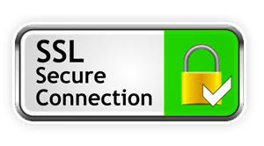
SSL Certificate
An SSL certificate is necessary to create SSL connection. You would need to give all details about the identity of your website and your company as and when you choose to activate SSL on your web server. Following this, two cryptographic keys are created - a Private Key and a Public Key. Next Steps:
A CSR (Certificate Signing Request) submission takes place, which is a data file that contains your details as well as your Public Key.
The CA (Certification Authority) would then validate your details.
After successful authentication, you will be issued SSL certificate. The newly-issued SSL would be matched to your Private Key.
From this point onwards, an encrypted link is established by your web server between your website and the customer's web browser.
Source: https://www.instantssl.com/ssl.html

Slide 7
SSL Certificate
Details of issuing CA (Certification Authority)
HTTPS
Padlock
Web browser trusts the CA
Source: https://www.instantssl.com/ssl.html
Google Chrome

Slide 8
SSL Protocol - encryption
In computing, encryption is the method by which plaintext or any other type of data is converted from a readable form to an encoded version that can only be decoded by another entity if they have access to a decryption key.
Source: https://searchsecurity.techtarget.com/definition/encryption

Slide 9
SSL protocol
An end-user asks their browser to make a secure connection to a website (e.g.https://www.example.com)
The browser obtains the IP address of the site from a DNS server then requests a secure connection to the website.
To initiate this secure connection, the browser requests that the server identifies itself by sending a copy of its SSL certificate to the browser.
Source: https://www.instantssl.com/ssl.html

Slide 10
SSl Protocol
The browser checks the certificate to ensure:
That it is signed by a trusted CA
That it is valid - that it has not expired or been revoked
That it confirms to required security standards on key lengths and other items.
That the domain listed on the certificate matches the domain that was requested by the user.
Source: https://www.instantssl.com/ssl.html

Slide 11
SSl Protocol
When the browser confirms that the website can be trusted, it creates a symmetric session key which it encrypts with the public key in the website's certificate. The session key is then sent to the web server.
The web server uses its private key to decrypt the symmetric session key.
The server sends back an acknowledgement that is encrypted with the session key.
From now on, all data transmitted between the server and the browser is encrypted and secure.
Source: https://www.instantssl.com/ssl.html

Slide 12
How to get an ssl
Step 1. Acquire SSL certificate
Step 2. Activate and install your SSL certificate
Step 3. Update Website from HTTP to HTTPS
Source: https://www.instantssl.com/ssl.html

Slide 13
Step 1. Acquire SSL certificate
To implement SSL/TLS security on your website, you need to get and install a certificate from a trusted CA (Certification Authority). A trusted CA will have its root certificates embedded in all major root store programs, meaning the certificate you purchase will be trusted by the internet browsers and mobile devices used by your website visitors.
Source: https://www.instantssl.com/ssl.html

Slide 14
Step 1. Select your option
Single domain certificates - one fully qualified domain name (FQDN).
Wildcard certificates - one single domain and unlimited subdomains of that domain. For example, a wildcard certificate for '*.domain.com' could also be used to secure 'payments.domain.com', 'login.domain.com', 'anything-else.domain.com'
Multi-domain certificates - multiple, distinct domains on a one certificate. For example, a single MDC can be used to secure domain-1.com, domain-2.com, domain-3.co.uk, domain-4.net and so on.
Extended Validation certificates - highest levels of security, trust and customer conversion for online businesses. Because of this, EV certificates contain a unique differentiator designed to clearly communicate the trustworthiness of the website to its visitors. Whenever somebody visits a website that uses an EV SSL, the address bar will turn green in major browsers such as Internet Explorer, Firefox and Chrome.
Source: https://www.instantssl.com/ssl.html

Slide 15
Step 2. Activate and install your SSL certificate
When SSL certificate is purchased from a web host, its activation is taken care of by the web host.
The administrator of the website can also activate the SSL through Web Host Manager (WHM) or cPanel.
Source: https://www.instantssl.com/ssl.html

Slide 16
Step 3. Update Website from HTTP to HTTPS
Your website is now capable of HTTPS! You must now configure you website so that visitors who access this site get automatically directed to the "HTTPS" version.
Search engine providers like Google are now offering SEO benefits to SSL pages, so the effort to serve all pages on your site over HTTPS is well worth it.
Source: https://www.instantssl.com/ssl.html

Slide 17
Who issues SSL Certificates?
Certificate authority or certification authority (CA)
Verifies two factors:
It confirms the legal identity of the enterprise/company seeking the certificate
Whether the applicant controls the domain mentioned in the certificate.
The issued SSL certificates are chained to a 'trusted root' certificate owned by the CA. Most popular internet browsers:
Firefox, Chrome, Internet Explorer, Microsoft Edge, and others have these root certificates embedded in their 'certificate store'.
Only if a website certificate chains to a root in its certificate store will the browser allow a trusted and secure https connection.
If a website certificate does not chain to a root then the browser will display a warning that the connection is not trusted.
Source: https://www.instantssl.com/ssl.html

Slide 18
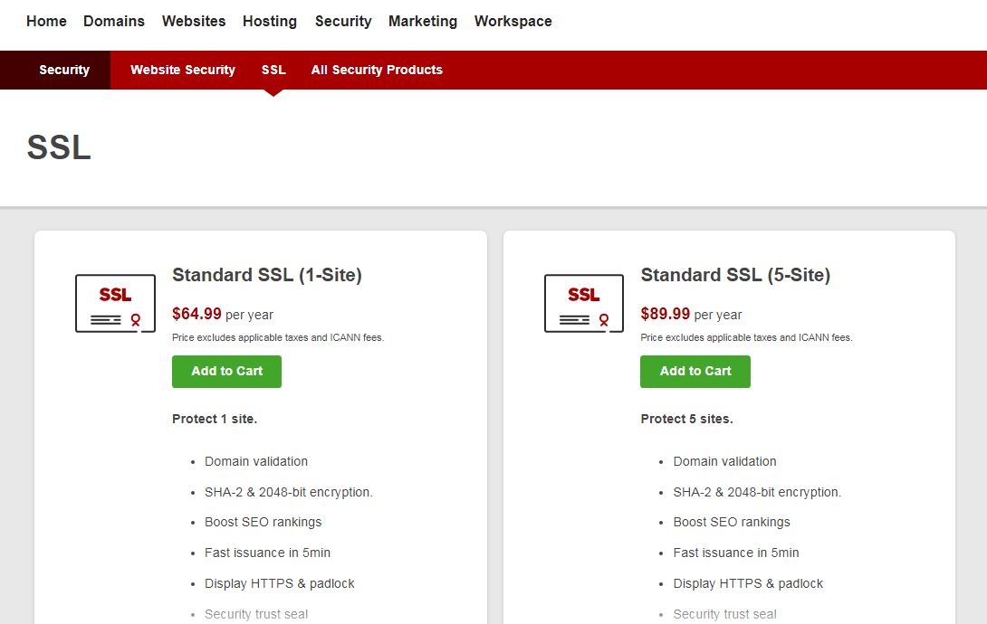
Costs and options
Source: https://www.inLimbic.com

Slide 19
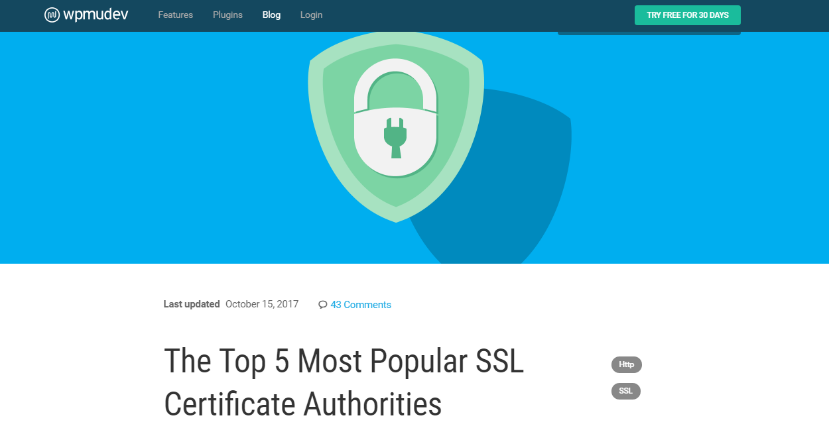
SSL Certification authorities
Source: https://premium.wpmudev.org/blog/ssl-certificate-authorities-reviewed/

Slide 20
Future of ssl
Cybercriminals continue to find holes in SSL
2014 – Heartbleed (cybercriminals to still gain access to the underlying information that was encrypted. All told, at least 500,000 websites were affected by Heartbleed, and this issue was around for years before it was widely discovered, CNET reported.
2015 – FREAK (various researchers discovered that they could force some websites running on older browsers to divert to an older, less secure version of SSL that is relatively easy to break, ZDNet reported. Dubbed FREAK, the exploit affected more than 33 percent of all sites that were using SSL at that time, according to researchers from the University of Michigan.)
Default for web traffic protection remains in doubt
SSL remains and will likely continue to be one of the best ways to safeguard traffic online
Source: https://www.untangle.com/inside-untangle/what-is-the-future-of-ssl/

Slide 21
Review
1) What does SSL stand for?
Secure Sockets Layer
2) What is needed in order to have an SSL connection?
SSL Certificate
3) What is the underlining protocol in an SSL connection?
Encryption
4) Who issues SSL Certificates?
A Certification Authority
5) What is the future of SSL?
SSL should continue to be the best way to safeguard traffic online

